Slide 1
UNIT FIVE
FLOW OF CONTROL IN A PROGRAM
PART TWO

Slide 2
PART ONE
SELECTION STATEMENT

Slide 3
Contents
Flow of Control
Control Statements
Sequential Statements
Selection Statement
  if----------Statements
  if---then---else Statements
  if—else—if—Statement
  Switch Statement
  Repetition or Iteration or Looping
    for-------loop
    while------loop
    do----while----loop

Slide 4
Control Statement (Structure)
Flow of control, is the order in which statements are executed, or determines which part are executed while other are inactive and how many times the statement has to be executed.
Normally, statements in a program execute one after the other in the order in which they are written.
The default flow of control is sequential.
This is called Sequential Execution.
All programs in many programming languages such as C++ are written in three control structures or statements namely:
Sequence
Selection
Repetition
These three control structure or statement is described in flow chart as follows in the next slide:

Slide 5
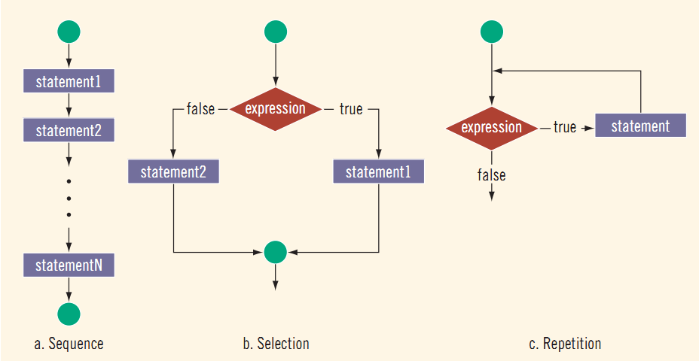

Slide 6
1. Sequence Structure in C++
Sequential statements are statements that are executed one after the other in the order they are written.
In this kind of statements the flow of control is said to be sequential.
Example
#include<iostream>
using namespace std;
int main() {
float num1, num2, num3;
cout<<"Enter any integer Number:";
cin>>num1;
num2=num1*10;
cout<<"Num1="<<num1<<endl;
cout<<"Num2="<<num2<<endl;
num3=num1*num2;
cout<<"Num3="<<num3<<endl;
cout<<"********END OF PROGRAM*****";
return 0;
}

Slide 7
Activity
1. Write C++ program to calculate VAT(15%), Service Charge(5%), Total Cost before VAT and Service Charge and Total Cash after VAT and Service Charge are added for the service that any business provided to the Customer. Suppose the Program is expected to accept Quantity and Unit Price as an input for the item or the service provided. And the Program is expected to display quantity, unit price, VAT, Service Charge, Total Cost before VAT and Service Charge and Total Cash as an output.
2. Write C++ program to determine the total Number of student in Unity University, Adama Campus from year 1 to 4 and the program is expected to calculate the amount money collected from each department separately and its total amount that the university earn from all department per month. Suppose the program is expected to accept number of students and its monthly payment in each department in each year as an input and display all the necessary information as an output.

Slide 8
2. Selection
It is a statement that tests whether an expression is true or false.
C++ mainly provides three types of selection statements.
if…selection Statement
Either performs an action if a condition is true or skips the action if the condition is false.
2. if----else--- selection Statement
Performs an action if a condition is true or performs a different action if the condition is false.
3. Switch--- selection Statement
Performs one of many different actions, depending on the value of an integer expression.

Slide 9
1) if -Selection Statement
It is used to execute a given set of statement or skipped based on the outcome of test condition.
It is a single-selection statement because it selects or ignores a single action.
Syntax
if(condition)
{
statement1;
-----------
----------
statement n;
}
Where condition is an integral expression and statement is any executable statement.
The statement will be executed only if the value of the integral expression is nonzero (if the condition or expression is True).

Slide 10
Example 1
Write a program that displays “WELCOME TO C++ PROGRAMMING” on the screen based on the user input such as the user press y from the keyboard and nothing is displayed on the screen if the user press character other than “y”.
#include<iostream>
using namespace std;
//Main Function
int main(){
//Declarationof Variables
char ch;
//Uses Press y from the keyboard
cout<<"Press y to print a message:";
cin>>ch;

Slide 11
    //Test if the condition is True or False
    if(ch=='y'){
    cout<<"WELCOME TO C++ PROGRAMMING"<<endl;
    }
    }
During the execution of the if statement, the parenthesized condition or expression is evaluated first.
If it evaluates to true, then the statement is executed and if it evaluates to false, then the statement is ignored and control passes to the next statement.

Slide 12
2. Write C++ program using if-statement to display the following output. Suppose the if condition is, if(code ==1)
  The water was too warm
  The water were all fished out
  It was too late in the season

Slide 13
1.1 ) Nested Simple if Statement
The general form or syntax of the nested simple if statement is:
if(condition1){
statement1a
…………….
if(condition2){
statement2a
……………….
if(condition3){
statement3a
………………..
}//End of condition3
statement2k
……………..
}//End of Condition2
statement1k
……………………….
}//End of Condition1

Slide 14
In order for a nested sub statement to be executed, all of the test conditions of the if’s under which this statement is nested must be true.
For example statement3a is only executed if the conditions 1, 2, and 3 all evaluates to true.
Similarly for statement2a to be executed only if the conditions in 1 and 2 are evaluated to True.
This type of construction can be used to define mutually exclusive sets .
The following example can be rewritten using the simple nested if construction to obtain mutually exclusive conditions. Error conditions could similarly have been included using nested simple if’s.

Slide 15
// C++ program to demonstrate nested if----statement
#include<iostream>
using namespace std;
int main(){
//Declaration of local variables
int score;
char grade;
//User input score value
cout<<"Enter the score: ";
cin>>score;
//Test the condition
if(score >=0){
if(score <=60){
grade='F';
cout<<grade;
}//End of inner if () statement

Slide 16
}//End of outer if () statement
//Test the ff nested if statement
if(score>60){
if(score<=70){
grade='D';
cout<<grade;
}//End of inner if ()
}//End of outer if()
//Test the ff if ()
if(score>70){
if(score<=80){
grade='C';
cout<<grade;
}//End of inner if ()
}//End of outer if()

Slide 17
//Test the ff if ()
if(score>80){
if(score <=90){
grade='B';
cout<<grade;
}//End of inner if ()
}//End of outer if()
if(score>90) {
if(score<=100) {
grade='A';
cout<<grade;
}//End of inner if ()
}//End of outer if ()
if(score>=101){
cout<<"INVALID INPUT";
}//End of inner if ()
return 0;
}//End of main ()

Slide 18
2) if-else ---Statement
The if..else statement causes one of two alternative statements to execute depending upon whether the condition is true.
It is called a double-selection statement because it selects between two different actions (or groups of actions).
Syntax
    if(condition){
    //statement1;
    }
    else{
    //statement2;
    }
When the conditional expression evaluates as true, statement1 is executed and the else section is ignored.
When the if conditional expression evaluates as false, statement1 is ignored, and statement2 is executed.

Slide 19
Activity
Write C++ program to determine either the number inputted by the user is positive or Negative
Use if-else statement and write C++ program to check either a number inputted by the user is odd or even.
Use if-else statement and write C++ program to determine either the number inputted by the user is less or greater with one another.
Read the following C++ code carefully and determine the output of the program.
#include<iostream>
using namespace std;
int main(){
int code;
code=2;
if(code !=2){

Slide 20
cout<<“The water was too warm.\n”;
cout<<“The water were all fished out \n”;
}//End of if()
else{
cout<<“It was too late in the season \n”;
cout<<“The bait was wrong \n”;
}//End of else()
cout<<“*** End of fishing excuses *** “;
return 0;
}//End of main ()

Slide 21
2.1 Nested- ifs--else
A nested if is an if statement that is the target of another if or else.
Nested ifs are very common in programming.
When you nest ifs, the main thing to remember is that:
An else statement always refers to the nearest if statement that is within the same block as the else and that is not already associated with an else.
Here is some example to demonstrate nested if--else:
  if(i = = 10) {
  if(j < 20) {
  a = b; //This statement is associated with the two ifs
  }//End of inner if()
  if(k >100){
  c = d; // this statement is within this if
  }

Slide 22
  //Inner else
  else {
  a = c; // associated with this else
  } //End of inner else()
  } //End of outer if ()
  else {
  a = d; // this else refers to if(i == 10)
  } //End of outer else ()
  As the comments indicate, the final else is not associated with if(j<20), because it is not in the same block (even though it is the nearest if without an else).
Rather, the final else is associated with if(i==10).
The inner else refers to if(k>100), because it is the closest if within the same block.
This kind of constructing a program creates a problem called Dangling-else problem.

Slide 23
Activity
1. Use nested ifs---else statement and write C++ program to find if an integer inputted by the user is even or odd or the number is (0) neither even nor odd.
/* C++ program to find if an integer is even or odd or neither (0) using nested if statements */
#include<iostream>
using namespace std;
int main() {
int num;
cout<<"Enter an integer: ";
cin>>num;
// outer if condition
if(num!=0) {
// inner if condition
if((num%2)==0) {

Slide 24
cout<<"The number is even."<<endl;
}//End of inner if ()
// inner else
else {
cout<<"The number is odd."<<endl;
}//End of inner else statement ()
}//End of outer if ()
// outer else
else {
cout<<"The number is (0) neither even nor odd."<<endl;
}//End of outer else statement
return 0;
}//End of main ()

Slide 25
2. Use nested ifs---else statement to avoid dangling problem and write C++ program to identify either the number x inputted by the user is “x is below average” if(x<=5) or “x is above average” if(x<=10) or “Invalid Input” if the x value inputted by the user is >10.

Slide 26
B) The if-else-if Statement
A common programming construct that is based upon a sequence of nested ifs is the if-else-if ladder.
Syntax of if-else-if:
    if(condition 1) {
    statement 1;
    }
    else if(condition 2){
    statement 2;
    }
    else if(condition 3) {
    statement 3;
    }
    else {
    statement n;
    }

Slide 27
The if—else--if statements are executed from the top to down.
As soon as one of the conditions controlling the if is true, the statement associated with that if is executed, and the rest of the ladder is bypassed.
If none of the conditions is true, then the final else statement will be executed.
The final else acts as a default condition; that is, if all other conditional tests fail, then the last else statement is performed.
If there is no final else and all other conditions are false, then no action will take place.

Slide 28
Example
Write C++ program to determine either the number is positive, negative or zero.
#include<iostream>
using namespace std;
//Main Function
int main(){
//Declaration of Variables
int n;
//Users assign the Value of n
cout<<"Enter the number n:";
cin>>n;
//Test the condition
if(n>0){
cout<<"The number n is positive. \n";
}

Slide 29
else if(n<0){
cout<<"The number n is Negative. \n";
}
else{
cout<<"The number n is Zero. \n";
}
cout<<"Bye ! Bye!";
return 0;
}//End of main()
Exercise
Write C++ program that performs the following input and output operation . Input Output
A or a Excellent
B or b Very Good
C or c Satisfactory D or d Not Satisfactory
F or f Failure
otherwise Invalid Input

Slide 30
2. Declare and Define a function by the name int Grade(int marks) and write C++ program to display a letter grade in upper case (Capital Letter) when Grade() function is called and return a value to the caller. The program is expected to accept marks as an input. Use the following input and output information to write the program.
Input Output
(marks>=90) and (marks<=100) A
(marks>=70) and (marks<90) B
(marks>=55) and (marks<70) C
(marks>=35) and (marks<55) D
(marks>=10) and (marks<35) F
otherwise I

Slide 31
3. Use if-else-if statement and write C++ program to calculate Income Tax, pension, total deduction and net payment of an employees. The program is expected to accept basic salary, allowance and credit association as an input and displays basic salary, allowance, credit association, growth salary, pension, income tax, total deduction and net payment that an employee earn as an output.
Hint:
Use 7% of Basic salary to compute pension.
Employee earn additional money as allowance monthly (not fixed allowance).
Employee must pay money monthly as a credit association (different values)
GrowthSalary=(BasicSalary +allowance).
TotalDeduction=(Pension+ IncomeTax + CreditAssociation)
NetPay=(GrowthSalary-TotalDeduction)

Slide 32
Use the following input and output information for tax competition or calculation.
Salary Tax Deduction
0-600 0 00
601-1650 10% 60.00
1651-3200 15% 142.50
3201-5250 20% 302.50
5251-7800 25% 565.00
7801-10,900 30% 955.00
>10,900 35% 1500.00
4. Declare and define the necessary function to calculate pension, growth salary, income tax, total deduction, and net salary of an employee when it is called and return a value to the caller.

Slide 33
Hint:
The program is expected to Input basic salary, allowance and credit association as an input and displays basic salary, allowance, credit association, growth salary, pension, income tax, total deduction and net payment as an output.
Employee earn additional money as allowance monthly (different values of allowance).
Employee must pay money monthly as a credit association (different values of credit association)
Pension=(BasicSalary*.07) when it is called and return a value to the main function ()
GrowthSalary=(BasicSalary +allowance) when a function is called and return avalue to the caller.

Slide 34
TotalDeduction=(Pension+IncomeTax+ CreditAssociation) when a function is called and return a value.
NetPay=(GrowthSalary-TotalDeduction) when it is called and return a value to the main program
Use the following input and output information for tax competition or calculation.
Salary Tax Deduction
0-600 0 00
601-1650 10% 60.00
1651-3200 15% 142.50
3201-5250 20% 302.50
5251-7800 25% 565.00
7801-10,900 30% 955.00
>10,900 35% 1500.00

Slide 35
3) switch-Statement
The switch selection statement is called a multiple-selection statement because it selects among many different actions (or groups of actions).
The switch statement can be used instead of the if--else-- if construct to implement a sequence of parallel alternatives.
Its syntax is used as follows:
    switch (expression){
    case <constant1>:
    statementList1;
    break;
    case <constant2>:
    statementList2;
    break;
    :
    :

Slide 36
    case <constantN>:
    statementListN;
    break;
    ……………………
    default: statementList0;
    }
The expression must evaluate to an integral type and the constants must be integral constants.
The expression used in switch statement is any legal C++ expression and the statements are any C++ legal statements or block of statements.
Switch evaluates expression and compares the result to each of the constant case value.
Note, however, that the evaluation is only for equality; relational operators may not be used here.

Slide 37
If one of the case values matches the expression execution jumps to those statements and continues to the end of the switch block, unless a break statement is encountered.
If nothing matches, execution branches to the optional default statement.
If there is no default and there is no matching value, execution falls through the switch statement and the statement ends.
It is important to note that if there is no break statement at the end of a case statement, execution will fall through to the next case statement. This is usually an error.
If you decide to let execution fall through, be sure put a comment, indicating that you didn’t just forget the break.
The following flow chart illustrates the switch statement clearly.

Slide 38
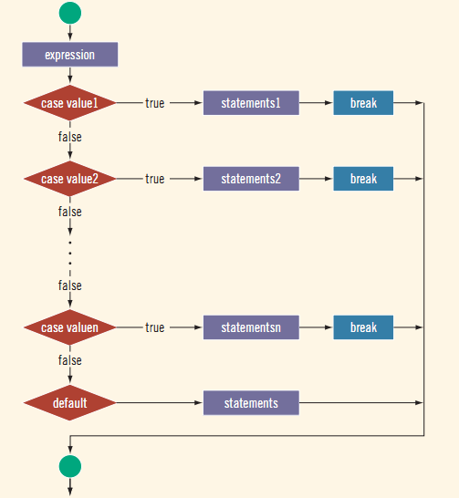

Slide 39
Write C++ program using switch statement based on the following input and output information.
Input Output
A Excellent
B Very Good
C Satisfactory
D Not Satisfactory
F Failure
otherwise Invalid Output

Slide 40
#include<iostream>
using namespace std;
int main(){
char ch;
cout<<"Enter the Grade :";
cin>>ch;
switch(ch){
case 'A':
cout<<"Excellent \n";
break;
//========================================
case 'B':
cout<<"very Good \n";
break;
//========================================

Slide 41
case 'C':
cout<<"Satisfactory \n";
break;
//=======================================
case 'D':
cout<<"Not Satisfactory \n";
break;
//=======================================
case 'F':
cout<<"Failure \n";
break;
default:
cout<<"Invalid Output \n";
}
cout<<"Bye! Bye!";
return 0;
}

Slide 42
Activity
2. Refer the above program that is implemented using switch statement in Q1. Rewrite the above program assuming that the program accepts input as upper and lower case letters and display the output accordingly when accepts both upper and lower case letters.
3. Write C++ program using switch statement to display a letter grade when users enters different range of marks. Use the following input and output information for your work.
Input Output
(marks>=90) and (marks<=100) A
(marks>=70) and (marks<90) B
(marks>=50) and (marks<70) C
(marks>=40) and (marks<50) D
(marks>=10) and (marks<40) F
otherwise I

Slide 43
LOOPING (ITERATION) STATEMENT
Part Two

Slide 44
3. Repetition Statements
C++ provides three types of repetition statements (also called looping statements or loops).
It enable programs to perform statements repeatedly as long as a condition remains true.
The repetition statements are the while, do...while and for …statements.
The while and for statements perform the action (or group of actions) in their bodies many times as if the condition is evaluated to true.
But if the loop-continuation condition is initially false, the statement will not execute.
The do...while statement performs the action (group of actions) in its body at least once.

Slide 45
All loops must have a starting position, an ending position and something to do over and over.
There are essentially two different ways of knowing when a loop has been repeated enough times.
When you know exactly how many times the loops you want to make.
An example of this would be if you wished this program to print the word Hello exactly 7 times.
We will call a loop of this kind a COUNT-LOOP.
2. When some conditions has been fulfilled,
An example of this when a set of numbers should be printed on the screen, one after another until the number 99 is reached.., then the looping should stop. We will call this a Condition-Loop
One method of controlling a loop is to create a special variable to keep track of the number of times the loop has been executed.
Such a variable called a counter.
The counter is increased by a fixed amount (usually by 1) each time the loop is executed.

Slide 46
LOOP CONTROL VARIABLE
is a variable whose value is used to determine the number of times a loop is repeated.
The counter variable is an example of a loop control variable.
It is mostly designated by either i, k, or m or n or words like count.
for---- Loop
Syntax
      for(expression1;expression2;expression3) {
      //Action statement (Body of the Loop)
      }
The for statement is a loop instruction that provides
An initialization part.
An expression- evaluation for terminating the loop and
A part to separate for the next iteration of the loop.

Slide 47
All three expression are required, but a null statement is valid for one of the expression.
The semicolon separating the expressions are required.
The expression in the for statement are:
Expression1
It is initialization part
It is always executes just once, as the first step in the execution process.
2. Expression2
is the test-expression (condition) for terminating the loop.
The test expression condition is evaluated each time to see if the body should execute.
The body executes when the result of the expression is True.
3. Expression3
is the part which prepares for the next iteration of the loop.

Slide 48
is also executes one for each time the body of the instruction executes.
This expression usually manipulates a variable that is used in expression2.
The above syntax can be rewritten as:
for (variable initialization; conditional expression; modification of variable){
      //Body of the loop
      }
The variable initialization allows you to either declare a variable and give it a value or give a value to an already declared variable.
The conditional expression tells the program that while the conditional expression is True, the loop should continue to repeat it self.
The variable modification section is the easiest way for a loop to handle changing of the variable.

Slide 49
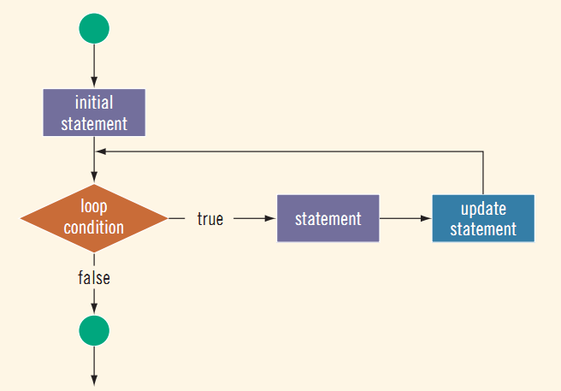
The Flow chart of for--- statement

Slide 50
Example 1:
C++ program is to illustrates for----loop to count and print integer number down starting from 10.
#include<iostream>
using namespace std;
//Main function
int main (){
//For loop
for(int n=10;n>0;n--){
//Body of for loop to print integer number
//down until n>0
cout<<n<<endl;
}//End of for---loop
return 0;
}//End of main ()

Slide 51
Note:
The initialization and increment ( decrement) fields are optional.
They can be avoided but not the semi colon signs among them.
For example, we would write:
for(;n<10;) if we want to specify no initialization and no increase; or
for(;n<10;n⁺⁺) if we want to include an increment field but not initialization.
Optionally, using the comma operator (,) we can specify more than one instruction in any of the fields included in a for loop, like in initialization.

Slide 52
Example, Suppose that we want to initialize more than one variable in our loop
for(n=0,i=100;n!=i; n++ ,i--) {
//what ever here
}
This loop will execute 50 times if neither n nor i are modified with in the loop.
n starts with 0 and i with 100 , the condition is (n!=i) (that n be not equal to i), because n is increased by one and i decreased by one.
The loop’s condition will become false after the 50th loop, when both n and i will be equal to 50.

Slide 53
Example 2
2. The following C++ program is to print Hello World five times in a separate line
#include<iostream>
using namespace std;
//Main function
int main (){
//Declaration of loop control variables
int i;
//For ----loop
for(i=1;i<=5;i++){
//Body of for--loop to print Hello World
cout<<"Hello World"<<endl;
}//End of for-----loop
return 0;
}

Slide 54
Note: The following two examples further illustrate how a for loop executes.
1. The following for loop outputs C++ Programming! and a star (on separate lines) five times:
    for (int i = 1; i <= 5; i++){
    cout << " C++ Programming “<< endl;
    cout << "* " << endl;
    }
2. Consider the following for loop to prints “C++ Programming! 5 times and star (*) one times.
    for (int i = 1; i <= 5; i++) {
    cout << “C++ Programming!" << endl;
    }
    cout << "* " << endl;

Slide 55
Example 3
3. Write C++ program to calculate factorial of any n natural number inputted by the user.
#include <iostream>
using namespace std;
//Main function
int main(){
//Declaration of control variables
int i;
//Declaration of variables to hold n natural
//number data as user inputed
int num;
//Declaration of variables to store factorial of
//n natural number and initialize to 1
int fact;
fact= 1;

Slide 56
//User input any n natural number
cout<<"Input any positive number:";
cin>>num;
//For -----Loop
for(i=1; i<=num; i++) {
//Calculate factorial of n natural number
fact*=i; // factorial = factorial * x;
}//End of for---loop
cout<<"Factorial of"<<" "<<num<<"="<<fact;
return 0;
}//End of main ()

Slide 57
Activity 1
Write C++ Program calculate the sum of n natural number inputted by the user using for statement.
Use for----loop and write C++ program to calculate square and sum of square of n natural number inputted by the user.
Use for----loop and if---else statement and write C++ program to calculate the sum of even and odd n natural number inputted by the user.
Use for----loop and write C++ program to calculate sum of the first 10 even number using for statement.
Write a program to calculate the sum of the first 10 odd number using for statement.
Write separate C++ program to calculate the reverse of sum of 10 even and odd numbers using for statement.

Slide 58
1.1 Nested for Loop
Loops may be nested, with one loop sitting in the body of another for loop.
The inner loop will be executed in full for every execution for the outer loop.
In for loop for example, if there is one for statement, there will be another for statement to be nested.
Usually use nested for---loop in matrix calculations.
Ex. column
row
Two Loop

Slide 59
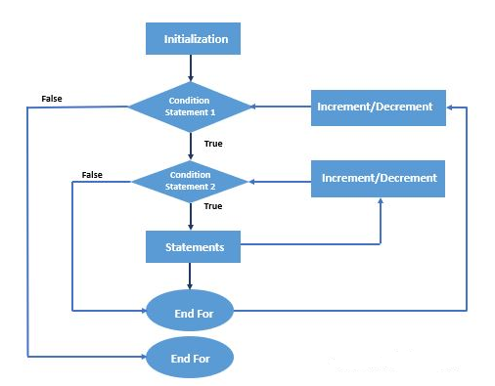
Flow chart that shows nested for---loop

Slide 60
//Program prints a multiplication table using nested for Loop
#include <iomanip> // defines setw() function
#include <iostream> // defines cout and cin
using namespace std;
int main(){//Main Function
//Outer For Loop to print columns
for (int x=1; x <= 12; x++){
//Inner For Loop used to print rows
for (int y=1; y <= 12; y++){
//Body of inner For Loop
cout<< setw(4) << x*y;
}//End of inner for Loop
//Body of Outer For Loop that prints new Line
//If the inner loop test condition is evaluated to False
cout << endl;
}//End of Outer For Loop
}//End of main ()

Slide 61
Each iteration of the outer x loop prints one row of the multiplication table.
For example, on the first iteration when x = 1, the inner y loop iterates 12 times, printing 1*y for each value of y from 1 to 12.
And then on the second iteration of the outer x loop when x = 2, the inner y loop iterates 12 times again, this time printing 2*y for each value of y from 1 to 12.
Note that the separate cout << endl; statement must be inside the outer loop and outside the inner loop in order to produce exactly one line for each iteration of the outer loop.
This program uses the stream manipulator setw to set the width of the output field for each integer printed.
The expression setw(4) means to “set the output field width to 4 columns” for the next output.

Slide 62
This aligns the outputs into a readable table of 12 columns of right-justified integers.
Stream manipulators are defined in the <iomanip> header, so this program had to include the directive #include <iomanip> in addition to including the <iostream> header.

Slide 63
Exercise
Write a program to display the following out put
* * *
* * *
* * *
#include<iostream>
using namespace std;
int main (){
int i,j;
for(i=1;i<=3;i⁺⁺)
{
for(j=1;j<=3;j⁺⁺)
{
cout<<“*”;
}
cout<<“\n”;
}
return 0;
}

Slide 64
THE break STATEMENT
We can also use break statement in loops as that of switch statement.
When it executes, it terminates the loop, “breaking out” of the iteration at that point.
Example:
/*C++ Program to reads a sequence of positive integers, Calculate Average of n Number Inputted by the user and terminate the loop when n number inputted by the user is n<=0 */
#include<iostream>
using namespace std;
//Main Function
int main() {
//Declaration of Variables that accept n number

Slide 65
int n;
//Declare another variable that counts the total n
//number inputted by the user and initialized to 0
int count=0;
//Declare a variable by the name sum to store the sum
int sum =0;
//User enter any positive integer and quite when enter 0
cout<<"Enter positive integers (0 to quit):"<< endl;
//For ever loop to continuously enter a number by the user
for (;;) {
//Use tab and started to count from 1 at run time
cout<<"\t"<<count+1<<":";
cin>>n;
//Test if the condition to determine to stop iteration or
//The break statement is executed and end the iteration
if (n <= 0){

Slide 66
break;
}//End of if()
//Increment count if iteration continues
count++;
//Calculate Sum of all n number
sum=(sum+n);
}//End of for ever loop()
//Display the average of all numbers inputted
cout<<"Average of those"<<" "<<count<<" "<<"positive numbers is"<<" "<<float(sum)/count<<endl;
return 0;
}

Slide 67
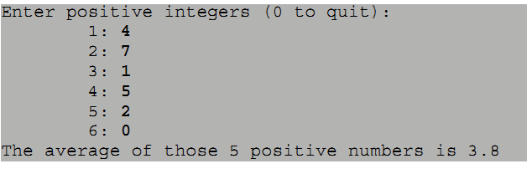
When 0 is input, the break statement executes, immediately terminating the for loop and transferring execution to the final output statement.
Without the break statement, the count++ statement would have to be put in a conditional, or count would have to be decremented outside the loop or initialized to –1.
Note that all three parts of the for loop’s control mechanism are empty: for (;;).
This construct is pronounced “forever.” Without the break, this would be an infinite loop.

Slide 68
Using a break Statement with Nested Loops
When used within nested loops, the break statement applies only to the loop to which it directly belongs; outer loops will continue, not affected by the break statement.
Let’s see the following C++program to print triangular multiplication table:
#include<iostream>
#include<iomanip>
using namespace std;
//Main Function
int main(){
//Outer for-------loop to count columns
for(int x=1; x<=12; x++){
//Inner for-----loop to count rows and print values

Slide 69
for (int y=1; y <= 12; y++){
//If Condition to ensure to execute break statement
//if the value of y>x but the outer loop continues to execute
if (y > x) {
break;
} //End of if()
else {
//Execute this part if y!>x
cout << setw(4) << x*y;
} //End of else()
} //End of inner for Loop
//Body of the outer for Loop
cout << endl;
} //End of outer for Loop
return 0;
}

Slide 70
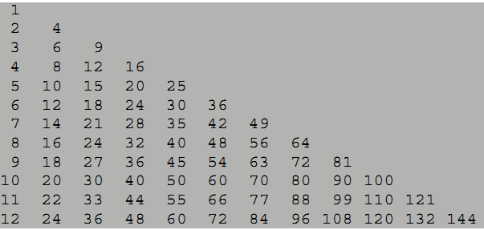
When y>x, the execution of the inner y loop terminates and the next iteration of the outer x loop begins.
For example, when x =3, the y loop iterates 3 times (with y = 1, 2, 3), printing 3 6 9 respectively.
Then on its 4th iteration, the condition (y > x) is true, so the break statement executes, transferring control immediately to the cout << endl statement (which is outside of the inner y loop).
Then the outer x loop begins its 4th iteration with x =4

Slide 71
1. Write C++ program to display the following shapes
a) * * * * b) * c) * * * *
* * * * * * * * *
* * * * * * * * *
* * * * *
d) * e) *
* * * *
* * * * * *
* * * * * * * *
f) # * * * *
* # * * *
* * # * *
* * * # *
* * * * #

Slide 72
THE continue STATEMENT
The break statement stops the loop in which it resides.
The program continues with the next statement immediately following the loop.
If the program uses single for loop, any statement under a for loop is not executed, the break statement enforces the control to move to the statement outside the loop and terminate the loop.
If the program uses nested for loop, the break statement skips(jumps) the inner for loop and its iteration of the outer for loop continues.
The continue statement causes the program to skip the rest of the loop in the current iteration and any statements inside a for loop is not executed if the condition to execute continue statement is evaluated to true.

Slide 73
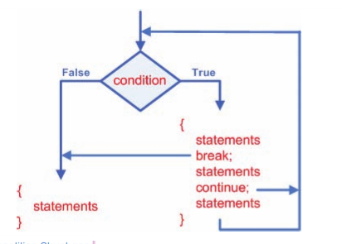
It skips the rest of the statements in the loop’s block, but instead of terminating the loop, it transfers execution to the next iteration of the loop.
It continues the iteration of the outer for loop after skipping the remaining statements in its current iteration or inner for loop.
The following flow chart shows the break and continue statement in a single for loop.

Slide 74
The following program is to demonstrate the continue statement by printing the odd number 1 to 29 and continue the iteration when x %2==0 and skip if not and prints the odd number
#include<iostream>
using namespace std;
//Main Function
int main(){
//Declaration of Control Variables
int x;
//For Loop to print a number 1 to 29
//And continue execution when x%2==0 and skip if not
for(x=0; x<=30; x++){
//Test if x%2==0
if(x % 2==0){

Slide 75
//If x%2==0, continue to the next iteration
continue;
}//End of if()
else{
cout<<x<<' ';
} //End of else()
} //End of for Loop
return(0);
}
Example
1. Use break statement in nested for loop and write C++ program to print the following shapes. The program skips from the inner for loop if(j==i) is evaluated to true by printing the statement next to the inner for loop and its iteration to the outer for loop is continue.

Slide 76

#include<iostream>
#include<iomanip>
using namespace std;
//Main Function
int main(){
//Declaration of control variables
int i,j;
//Outer for--loop to count cols
for(i=0;i<4;i++){
//Inner for loop to count no of rows and print *
for(j=4;j>=0;j--){
//Test if() condition to execute break statement
if(j==i){

Slide 77
//Execute if (j==i) is evaluated to true but the outer loop execution continues
break;
}//End of if ()
else{
//Print * if (j!<i)
cout<<setw(4)<<"*";
}//End of else()
}//End of inner for--loop
//Print new line or execute the outer loop as if
//the break statements jumps to this body
cout<<endl;
}//End of outer---for--loop
return 0;
}//End of main ()

Slide 78

2. Use continue statement in nested for loop and write C++ program to print the following shapes. The program continue its iteration of the inner for loop as if(j>i) is evaluated to true but executes the statement in the inner for loop if(j>i) is evaluated to true and the outer for loop continue its iteration after the test condition of the inner for loop is evaluated to true and prints cout statement (new line) inside the outer for loop.

Slide 79
#include<iostream>
#include<iomanip>
using namespace std;
//Main Function
int main(){
//Declaration of index variables
int i,j;
//Outer for--loop to count rows
for(i=1;i<=4;i++){
//Inner for loop to count no of cols and print *
for(j=1;j<=4;j++){
//Test if() condition to execute break statement
if(j>i){
//Execute if (j>i) is evaluated to true
//But the inner for loop execution continues
continue;

Slide 80
}//End of if ()
else{
//Print * if (j!=i)
cout<<setw(4)<<"*";
}//End of else()
}//End of inner for--loop
//Print new line or execute the outer loop as if
//the continue statements jumps to this body
cout<<endl;
}//End of outer---for--loop
return 0;
}//End of main ()

Slide 81
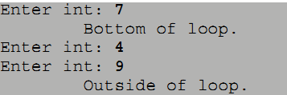
Using continue and break Statements
1. Write C++ program to demonstrate continue and break statement in for---ever loop. Suppose the program displays the following after the user enter a number 7, 4 and 9 respectively.
#include<iostream>
using namespace std;
//Main Function
int main(){
//Declaration of Control Variable
int n;

Slide 82
//For Ever Loop
for (;;){
//User Assign the value of any n integer Number
cout<<"Enter any integer Number:";
cin>>n;
//Outer if Statement to continue the next iteration
if(n%2==0) {
continue;
} //End of outer if()
//Inner if() Statement
if(n%3==0) {
break;
}
//Statement within the inner if()
cout<<"\t"<<"Bottom of the loop"<<endl;
}//End of inner if()

Slide 83
//Statement where control breaks out of the loop and
//jumps immediately to the first statement that follows the loop
cout<<"\t"<<"Outside of the loop"<<endl;
return 0;
}
When n has the value 7, both if conditions are false and control reaches the bottom of the loop.
When n has the value 4, the first if condition is true (4 is a multiple of 2).
So control skips over the rest of the statements in the loop and jumps immediately to the top of the loop again to continue with its next iteration.
When n has the value 9, the first if condition is false (9 is not a multiple of 2) but the second if condition is true (9 is a multiple of 3).
So control breaks out of the loop and jumps immediately to the first statement that follows the loop.

Slide 84
Example
Use continue and break statement together in a single for loop and write C++ program to print a number 1 2 3 4 6 7 8 and 9. The program skips to print 5 when continue statement is executed but its next iteration continues but terminate the loop when break statement is executed when the control variable counts reach to 10.
#include <iostream>
#include<iomanip>
using namespace std;
int main(){
//for----loop
for(int counter=1; counter<10; counter++){
/*Test the condition to execute continue statement if the condition is evaluated to true, the statement inside the for loop is not executed but its next iteration in the loop continues */

Slide 85
if(counter==5){
//skip 5, it is not print 5 if counter==5
continue;
}//End of if()
//Test the condition to skip the statement in loop's block and
//terminate the for--loop
if(counter==10){
/*Stops the looping process when counter==10 and the statement inside the for loop is not executed and the loop terminates */
break;
}//End of if()
cout<<setw(4)<<counter<<" ";
}//End of for loop
return 0;
}//End of main ()

Slide 86
THE goto STATEMENT
The break statement, the continue statement, and the switch statement each cause the program control to branch to a location other than where it normally would go.
The destination of the branch is determined by the context:
break goes to the next statement outside the loop,
continue goes to the loop’s continue condition,
switch goes to the correct case constant.
All three of these statements are called jump statements because they cause the control of the program to “jump over” other statements.
goto statement is used for altering the normal sequence of program execution by transferring control to some other part of the program.
The goto statement is another kind of jump statement.

Slide 87
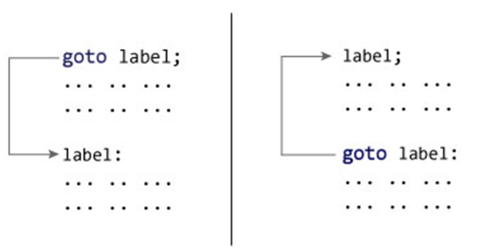
Its destination is specified by a label within the statement.
A label is simply an identifier followed by a colon placed in front of a statement.
Labels work like the case statements inside a switch statement: they specify the destination of the jump.
The syntax how to use the goto statement is as follows:

Slide 88
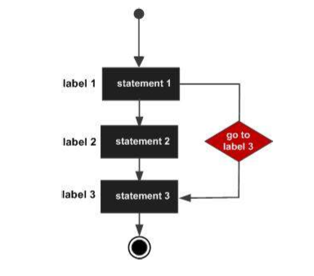
The flow diagram for goto statement is as follows:

Slide 89
Example 1
1. Write C++ program to demonstrate the goto statement inside the if condition to jump and move to the destination if x<10.
#include<iostream>
#include<iomanip>
using namespace std;
int main (){
//Declaration of variables and initialize to 1
int x;
x=1;
//Define a label to specify the destination of the jump
start:
/*Increment x to determine the next jump statement and display the value of x until the test condition is evaluated to true */

Slide 90
x++;
//Display the value of x until the condition is evaluated to true
cout<<setw(4)<<x<<" ";
//Test the condition if x<10 and control jump to the label
if(x<10){
//Go to the label if the value of x<10
goto start;
}//End of if()
return 0;
}//End of main ()
1. Read the above C++ program carefully and determine the output of the program you expect.

Slide 91
Example 2: Write C++ program to demonstrate goto statement. Suppose the program displays the following output:
count=5
count=10
count =15
count=20
count=25
count=30
count=35

Slide 92
Top and Bottom Tested Loop
Control structures are commands that choose which lines of code will be executed.
Some control structures you have already seen are the if command and the for command.
A for loop like the following is a good way to repeat commands if you know how many times they must be repeated.
for(count=0;count<10;count⁺⁺)
{
//code here is done 10 times
}
However, this is not convenient if you do not know how many times the loop will have to be executed.
There are two ways to set up a loop that determines when to quit after it has started being repeated.
These are called a top tested loop and a bottom tested loop.

Slide 93
Definition
A top tested loop is one in which the conditions for running the loop are tested before the loop is executed.
As such, the loop may not be executed even once.
A top tested loop in C++ looks like this.
    while (menu_pick !=0) {
    //do these commands until menu_pick equals to 0
    }
2. A bottom tested loop is one that decides whether to do the loop again after it has been executed.
Because of this, the loop is always executed the first time and will repeat until the condition is met.
A bottom tested loop in C++ looks like this.
    do {
    //run these commands, then decide whether to do them again
    }
    while (menu_pick !=0);

Slide 94
1. While Structure (Top Tested Looping)
is one in which the expression or condition for running the loop are tested before the body of the loop is executed.
Therefore, the loop may not be executed even once or executed multiple times.
    Syntax
    while(<test-expression>)
    {
    <statement sequence>
    }
The expression must evaluate to a true (1) or false (0) result.
While the expression is true, the program repeatedly executes statement.
Sooner or latter, expression must become false so the loop ends.
If expression never becomes false, the program will hang, and you have to reboot to recover.

Slide 95
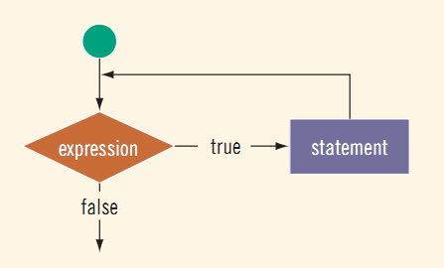
In while loop we have only test expression but performs the initialization and execution /increment explicitly.
If we ignore the increment/decrement ,it directly enter to infinite loop.
Initialization should be performed outside the loop (above the loop).
Increment, decrement and execution is part of the statement sequence.
Figure: shows the flow of execution of a while loop

Slide 96
Example 1
//C++ program to count a number down where the
//starting number is inputted by the user
#include<iostream>
#include<iomanip>
using namespace std;
//Main Function
int main ()
{
//Declaration of Variables
int n;
//User assign the starting value of any n number
cout<<"Enter the value of any n number:";
cin>>n;
//While Loop
while(n>0){

Slide 97
/*Body of the while Loop decrement and statements to be executed */
cout<<setw(4)<<n;
n--;
}//End of While Loop
return 0;
}//End of main()
Example 2: Write a program to calculate sum of the first 10 natural numbers using while loop
/*C++ Program to calculate the sum of the first 10 Natural Numbers */
#include<iostream>
using namespace std;
//Main Function
int main (){
//Declaration of Variables and initialize num to 1 and sum to 0

Slide 98
int num, sum;
num=1;
sum=0;
//While Loop
while(num<=10){
//Calculate Sum
sum=(num+sum);
//Increment the value of num
num++;
}//End of While Loop
//Display the Sum
cout<<"Sum="<<sum;
return 0;
}//End of main ()

Slide 99
Example 3: Write a program to read n numbers and print out their squares
/*C++ program to calculate the square of any n number inputted by the user repeatedly until the user enter negative or zero to quite the program */
#include<iostream>
using namespace std;
//Main function
int main (){
//Declaration of variables
int n;
//Users assign the value of any n integer number
cout<<"Enter an integer (negative number or zero to quite):";
cin>>n; //get first number
//While Loop
while (n>0){

Slide 100
//Calculate the square of n number
n=(n*n);
//Display Output
cout<<" The square of n number="<<n<<endl;
//Continue the Loop to inform the user to enter next n number
cout<<"Enter an integer (negative number or zero to quit):";
cin>>n; //Get next number
}//End of While () Loop
return 0;
}//End of main ()

Slide 101
TERMINATING A LOOP
//C++ Program to terminate the while loop
//immediately when the value of i> n
#include<iostream>
using namespace std;
//Main Function
int main() {
//Declaration of Variables
int n, i;
long sum;
//Initialize i to 1 and sum to 0
i=1;
sum=0;
//User assign any n positive integer
cout<<"Enter any n positive integer:";
cin>>n;

Slide 102
//While Loop which counts forever
while(true) {
//Test the condition
if (i > n) {
// terminates the loop immediately when i>n
break;
}
//Calculate the sum
sum=(sum+i);
//Increment i
i++;
} //End of while loop()
//Display output
cout<<"The sum of the first"<<" "<<n<<" "<<"integers is"<<":"<<sum;
}

Slide 103
As soon as the value of i reaches n, the loop terminates and the output statement at the end of the program executes.
Note that the control condition on the while loop itself is true, which means continue forever.
One advantage of using a break statement inside a loop is that it causes the loop to terminate immediately, without having to finish executing the remaining statements in the loop block.
Example: Write C++ program to terminate the loop (or exit from the loop) when counter>10 is evaluated to true.

Slide 104
//C++ Program to terminate the Loop when
//the counter reaches to 11 or n>10 and prints the counter
#include<iostream>
using namespace std;
int main() {
//Declaration of Variables and initialized to 0
int counter = 0;
//While Loop to counts the loop
while (1) {
//Increment counter
counter ++;
//Test the Condition
if (counter > 10){
//Terminate the loop immediately or execute break when n>10
break;

Slide 105
}//End of if()
}//End of While Loop
cout<<"Counter= "<< counter<<endl;
return 0;
}

Slide 106
Using the exit(0) Function
//C++ Program used the exit() fun provides another way
//To terminate a loop, When exit () executes
//The program terminates immediately
#include<iostream>
using namespace std;
//Main Function
int main() {
long n;
cout<<"Enter any n positive integer: ";
cin>>n;
cout<<"Fibonacci numbers of "<<" "<<n<<endl;
//Declaration of variables by f0 and f1 and
//Initialize f0 to 0 and f1=1
long f0,f1;
f0=0, f1=1;

Slide 107
//While Loop to iterate
while (true){
//Declare another variable f2
long f2;
//Add the value of f0 and f1 and assign to f2
f2= f0 + f1;
//Test the condition to ensure (f2>n)
if(f2> n) {
// terminates the program immediately when f2>n
exit(0);
}//End of if ()
//Display the output
cout<<f2<<" ";

Slide 108
//Assign the value f1 to f0 and value of f2 to f1 every iteration
f0 = f1;
f1 = f2;
}//End of while()
return 0;
}//End of main ()

Slide 109
Activity 1
Write C++ program to display “Welcome to C++ program” and “*” five times respectively.
Write C++ Program for the sum and average of n natural number inputted by the user using while Loop.
Write C++ program to calculate factorial of n number inputted by the user using while Loop.
Write C++ program allows the user to enter a maximum number of digits and then, the program will sum up the odd and even numbers from 1 to entered digits using a while loop and display its sum of both odd and even number.
Write C++ program to find and display the sum of an positive integer inputted by the user and if the user inputs negative numbers, execute break and ends the loop and the negative number inputted is not added to sum

Slide 110
2. do-while Statement
It is a bottom nested loop that allows its body of instructions to be executed one or many times.
do {
statement
}
while (condition);
where condition is an integral expression and statement is any executable statement.
It repeatedly executes the statement and then evaluates the condition until that condition evaluates to false.
The do..while statement works the same as the while statement except that its condition is evaluated at the end of the loop instead of at the beginning.
This means that any control variables can be defined within the loop instead of before it.
It also means that a do...while loop will always iterate at least once, regardless of the value of its control condition.

Slide 111
Example 1
// Demonstrates skipping the body of
// the do--while loop when the condition is false.
#include<iostream>
using namespace std;
int main() {
//Declaration of Control Variables Variables
int counter;
cout<<"How many C++ Programming needs to print?:";
cin>>counter;
//do While
do{
cout<<"C++ Programming"<<endl;
//Decrement/increment mus inside the loop
counter--;
}

Slide 112
while (counter > 0);
cout<<endl;
//Display the foll string if counter>0 is evaluated to false
cout<<"Counter OutPut is:"<<counter;
return 0;
}
Example 2: Write C++ program using do----while loop to print the following output: 20 30 40 50 60
// C++ program to demonstrate do--while Loop
// The program is expected to print 20 30 40 50 60
#include<iostream>
using namespace std;
//Main Function ()
int main() {

Slide 113
//Declaration of variables and initialized to 10
int i=10;
//do----Statement
do{
//Display the value of i before it is modified
cout<<i<<" ";
//Add 10 at each iteration on i
i= i+10;
}//End of do
//Test the condition until the value of i<=60
while (i<=60);
return 0;
} //End of main ()

Slide 114
Example 3: Write C++ Program to calculate the sum any n consecutive positive number using do---while Loop.
#include<iostream>
using namespace std;
//Main Function ()
int main(){
//Declaration of Variables n and i and initialized i=1
int n,i=1;
//Users assign anny n positive integer
cout<<"Enter n positive integer:";
cin>>n;
//Declaration of Variables by sum and initialized to 0
long sum=0;

Slide 115
do {
//Add sum and i iteratively
sum= (sum+i);
//Increment i
i++;
}
//Test until the value of i<=n
while(i<=n);
//Display output
cout<<"The sum of the first"<<" "<<n<<" "<<"integers are:"<<sum;
}

Slide 116
Activity 1
Write C++ Program to print English Upper Case Alphabet using do---While Loop
Use do ---while loop and write C++ program to count and display positive integer inputted by the user and terminate the loop when n number inputted by the user is n<20.
Write C++ Program for the sum and average of n natural number using do----while Loop. The program is expected to accept any n number from the user.
Write C++ program allows the user to enter a maximum number of digits and then, the program will sum up the odd and even numbers from 1 to entered digits using do while loop and display its sum of both odd and even number
Write separate C++ program to calculate the reverse of sum of 10 even and odd numbers using while loop.

